Slide 1
Motivational Theories
ABDUL RAHEEM RIHAM AHAMED
HND COMPUTING IDM

Slide 2
Table of contents
What is motivation?
Maslow’s Need Hierarchy Theory
Apply Maslow’s Need Hierarchy Theory
Herzberg’s Motivation Hygiene Theory
Apply Herzberg’s Motivation Hygiene Theory
McGregor’s Participation Theory
McClelland’s Need Theory
Vroom’s Expectancy Theory
Conclusion

Slide 3

What is motivation?
A motive is a biological desire to cause a person to take action regarding some task.
Motivation is an inbuilt process
that pushes a person towards
a goal.
There are 2 main theories that
attempt to discuss this process
Drive Reduction Theories
Hierarchy of needs theory

Slide 4
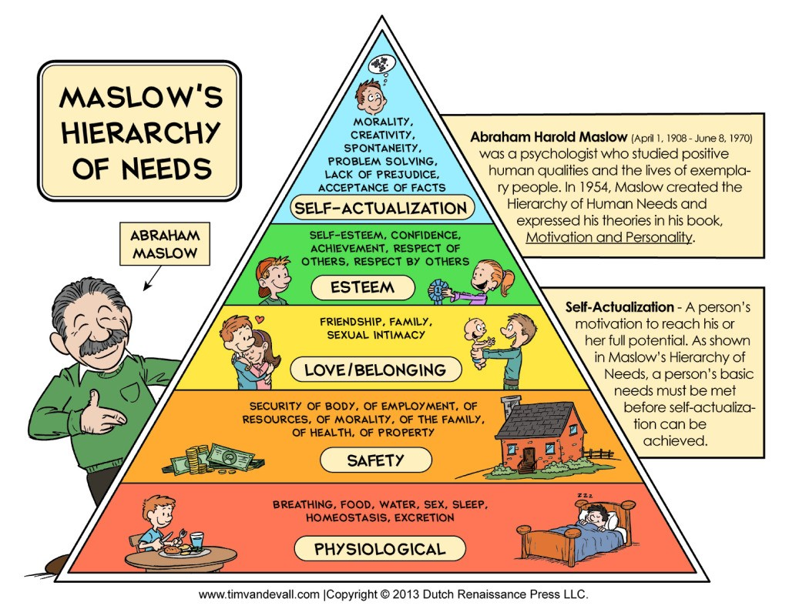
Maslow’s Need Hierarchy Theory
One of the most well-known theories of motivation. This theory effectively states all human needs from lowest to highest order.
Psychological Needs
Safety Needs
Social Needs
Esteem Needs
Self-Actualization Needs

Slide 5
Apply Maslow’s Need Hierarchy Theory
Chip Conley, founder of the Joie de Vivre hotel chain and Head of Hospitality at Airbnb, used the Hierarchy of Needs pyramid to transform his business.
In order to apply this theory, the teams were bought to a point they realized the importance of their job to the company and the countless people it helps.

Slide 6
Herzberg’s Motivation Hygiene Theory
This theory extends the previously mentioned theory and proposed a new theory called also the 2-factor theory.
According to Herzberg, the opposite of satisfaction is not dissatisfaction.
He goes on to say that there exists a dual continuum.
The opposite of satisfaction is no satisfaction and the opposite of dissatisfaction is no dissatisfaction, hence the name “2-factor”.

Slide 7
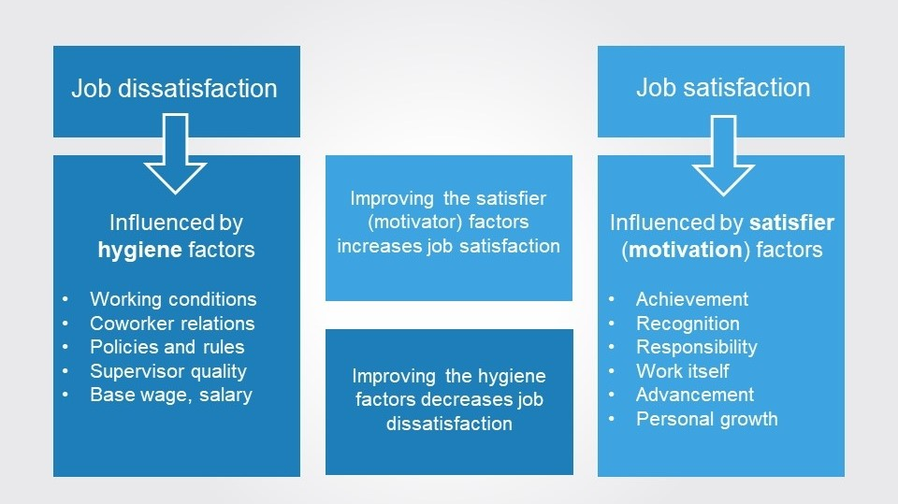
Apply Herzberg’s Motivation Hygiene Theory
This theory implies that for the happiest and most productive workforce, you need to work on improving both motivator and hygiene factors.
To help motivate your employees, make sure they feel appreciated and supported.
Give plenty of feedback and make sure your employees understand how they can grow and progress through the company.

Slide 8
McGregor’s Participation Theory
This theory is unlike the former 2 theories.
He came up with 2 distinct views of a human being based on participation in work.
The first set is labelled negative is called Theory X.
The second set is labelled positive and is called Theory Y.

Slide 9
McClelland’s Need Theory
This is also one of the most well-known theories but this theory opposes the theory of the hierarchy of needs.
He goes on to say that people who have some sort of need behave differently from those who don’t.
He focuses on 3 core needs:
Need for achievement
Need for power
Need for affiliation

Slide 10
Vroom’s Expectancy Theory
This is also one of the most well-known theories.
It is called a cognitive process theory for motivation.
The theory is based on the fact that a person will be motivated in order to exert a higher level of effort given there are relationships between the effort the exert, the performance and the rewards.

Slide 11
Conclusion
Motivation is the process by which an individual takes action due to some factor.
There are numerous motivational theories trying to explain the psychological viewpoint of motivation.
The theories break off to different branches but all of them have one thing in common, and that is to ensure that team members understand each other.
Comprehension and reasoning with each other leads to a friendlier environment and therefore to a motivated work force.

Slide 12
THANK YOU

